Slide 1
Trabajo final de estructura de datos
Eduardo Araujo Sarmiento
Dayana Armas Benavides

Slide 2
Tabla de contenido
01
02
03
04
Introduccion
Listas
Colas y Pilas
Árboles

Slide 3
01
Introducción
Presentacion y visualización general del programa

Slide 4
02
Listas
Listas Enlazadas Simples y ArrayList

Slide 5
03
Pilas y Colas
Pila, Cola y Bicola

Slide 6
04
Árboles
Árbol, Recorridos y Xml-Linq (CRUD)

Slide 7
Whoa!
This can be the part of the presentation where you can introduce yourself, write your email…

Slide 8
Introduction
It consists of the process of designing and building a computer program to achieve a computer result or to perform a task

Slide 9
—Someone Famous
“This is a quote, words full of wisdom that someone important said and can make the reader get inspired”

Slide 10
The slide title goes here!
Do you know what helps you make your point clear? Lists like this:
They’re simple
You can organize your ideas
You’ll never forget to buy milk!
And the audience won’t miss the point of your presentation

Slide 11
Student learning
Programming
Venus has a beautiful name and is the second planet from the Sun
Operating systems
Mercury is the smallest planet in the entire Solar System

Slide 12
Subjects
Software
Venus is the second planet from the Sun
Programming
Saturn is a gas giant and has several rings
Theory
Neptune is the farthest from the Sun

Slide 13
Operating systems

Slide 14

A picture
always reinforces
the concept
Images reveal large amounts of data, so remember: use an image instead of long texts

Slide 15
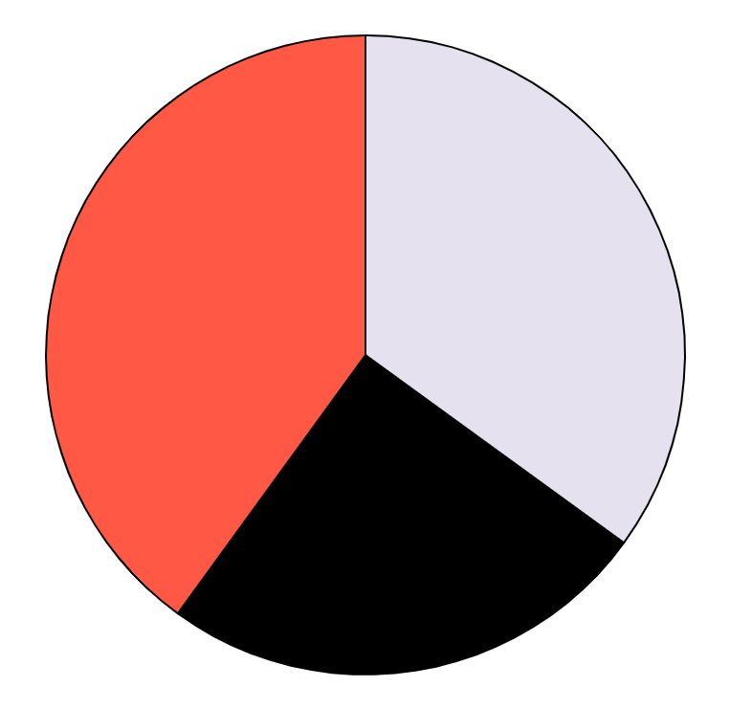
Our data
35%
Consultant
40%
Venus is the second planet from the Sun
Engineer
Saturn is a gas giant and has several rings
25%
Designer
Despite being red, Mars is a cold place
Follow the link in the graph to modify its data and then paste the new one here. For more info, click here

Slide 16
Common programming language
Html
Javascript
Java
Mercury is a really small planet
Venus is the second planet from the Sun
Despite being red, Mars is a cold place
Python
SQL
CSS
Saturn is a gas giant and has several rings
Jupiter is the biggest planet of them all
Neptune is the farthest from the Sun

Slide 17
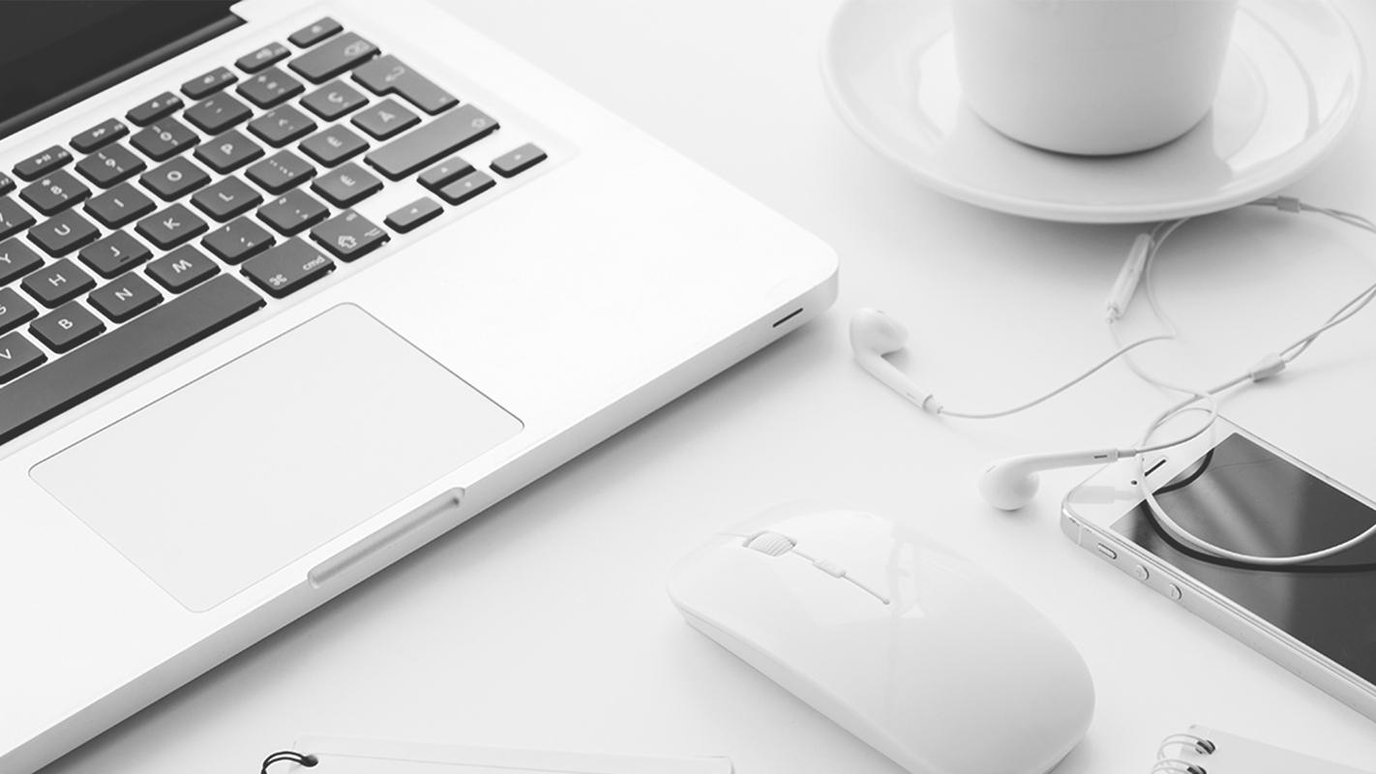
A picture is worth a thousand words

Slide 18
Computer programmers
Maintenance
Coding
Despite being red, Mars is a cold place
Neptune is the farthest from the Sun
Integration
Specification
Venus is the second planet from the Sun
Jupiter is the biggest planet of them all

Slide 19
Programming languages
Input | Despite being red, Mars is a cold place
Output | Mercury is the closest planet to the Sun
Arithmetic | Venus is the second planet from the Sun
Repetition | Neptune is the farthest from the Sun

Slide 20
Universities
Columbia
Neptune is the farthest from the Sun
Stanford
Jupiter is the biggest planet of them all

Slide 21
Timeline
1994
1995
1996
2000
PHP
Javascript
Java
C#
Despite being red, Mars is a cold place
Venus is the second planet from the Sun
Mercury is the closest planet to the Sun
Jupiter is the biggest planet of them all

Slide 22
1952
Year in which the first programming language was configured

Slide 23
333,000.00
9h 55m 23s
386,000 km
earths is the Sun’s mass
is Jupiter’s rotation period
is a very long distance

Slide 24
This is another table
Fortran | Despite being red, Mars is a cold place | Saturn is a gas giant and has several rings
Lisp | Mercury is the closest planet to the Sun | Jupiter is the biggest planet of them all
Python | Venus is the second planet from the Sun | Neptune is far away from Earth

Slide 25
Diagram
Programming
Mercury
Mars
Jupiter is the biggest planet of them all
Despite being red, Mars is a cold place
Saturn is a gas giant and has several rings
Earth is the planet where we all live on

Slide 26
Need more text columns?
Mercury
Venus
It’s the closest planet to the Sun
Venus is the second planet from the Sun
Mars
Saturn
Despite being red, Mars is a cold place
Saturn is a gas giant and has several rings

Slide 27
Our team
Helena Doe
John James
You can speak a bit about this person here
You can speak a bit about this person here

Slide 28
Calendar
October 2021
Mo | Tu | We | Th | Fr | Sa | Su
 |  |  |  | 1 | 2 | 3
4 | 5 | 6 | 7 | 8 | 9 | 10
11 | 12 | 13 | 14 | 15 | 16 | 17
18 | 19 | 20 | 21 | 22 | 23 | 24
25 | 26 | 27 | 28 | 29 | 30 | 31
October 4th
Despite being red, Mars is a cold place

Slide 29
Programming language data
25%
59%
83%
Venus
Mars
Saturn
Venus is the second planet from the Sun
Despite being red, Mars is a cold place
Saturn is a gas giant and has several rings

Slide 30
Our conclusions
Neptune
Neptune is the farthest planet from the Sun
Saturn
Saturn is a gas giant and has several rings
Jupiter
It’s the biggest planet in the Solar System

Slide 31
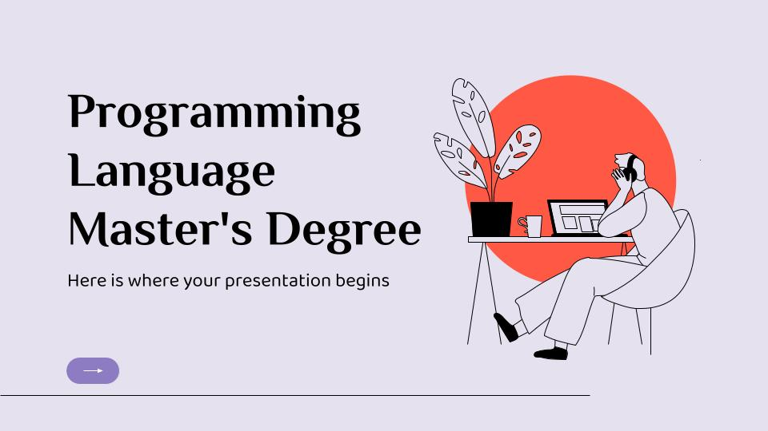
Desktop software
You can replace the image on the screen with your own work. Just right-click on it and select “Replace image”

Slide 32

Tablet app
You can replace the image on the screen with your own work. Just right-click on it and select “Replace image”

Slide 33

Smartphone
You can replace the image on the screen with your own work. Just right-click on it and select “Replace image”

Slide 34
Thanks!
Do you have any questions?
addyouremail@freepik.com
|+91 620 421 838 | yourcompany.com
Please, keep this slide for the attribution

Slide 35
Alternative resources

Slide 36
Alternative resources
Vectors:
People analyzing growth charts illustrated
Online courses tutorials
Photos:
College girls studying together
Close up hand taking notes
Female student learning english online
English teacher elements arrangement
Content black man posing with laptop
Close up girl learning online

